Slide 1
Back to School Night
6th and 7th Grade Science LBMS
Room 3051 – Mrs. Howard
khoward@longbranch.k12.nj.us

Slide 2
My website
www.kimhowardscience.weebly.com
Class guidelines and expectations
Copies of worksheets, videos, homework
Web links to relevant websites

Slide 3
6th and 7th Grade Science
Long Branch Middle School Teacher Pages, Kimberly Howard or
https://www.longbranch.k12.nj.us/Domain/1542 (will have a link to my personal teacher website)
My personal teacher website will have copies of slide presentations, videos, songs, projects and general information:
www.kimhowardscience.weebly.com

Slide 5
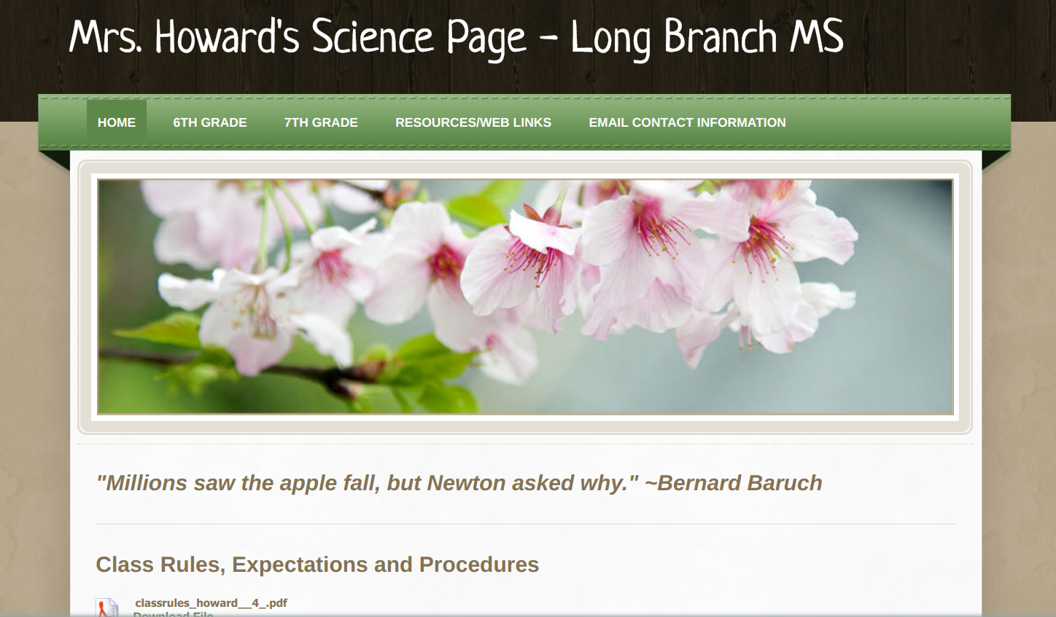

Slide 6
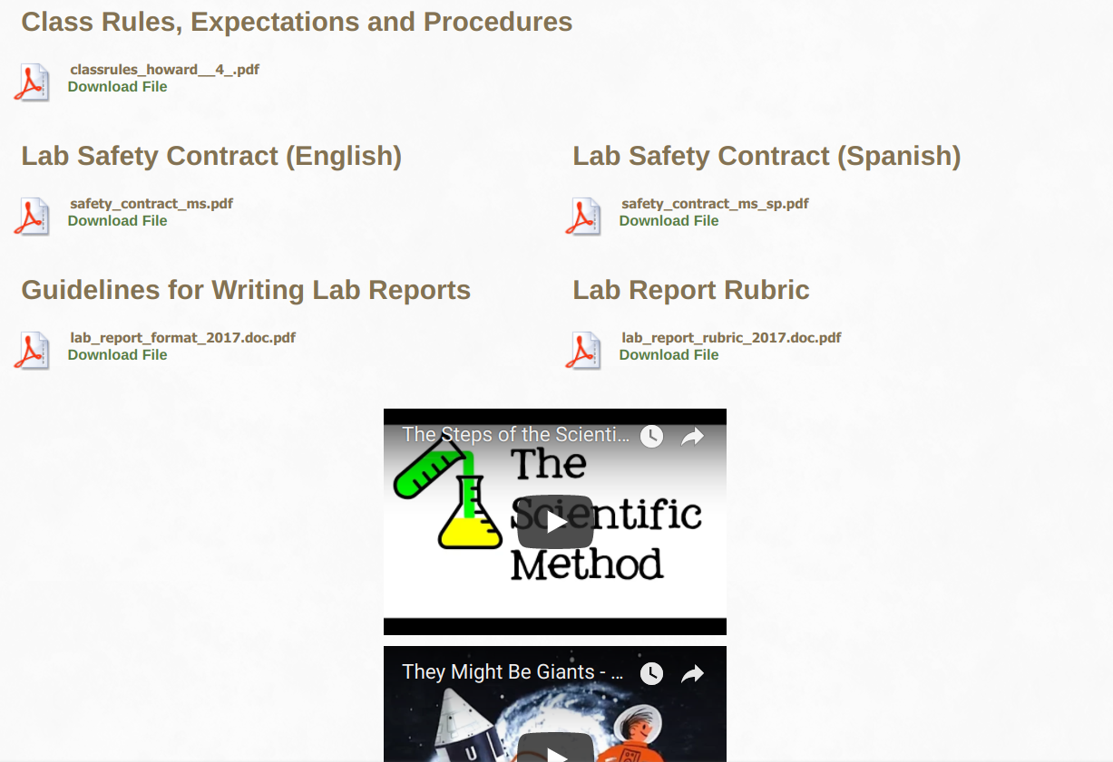

Slide 7
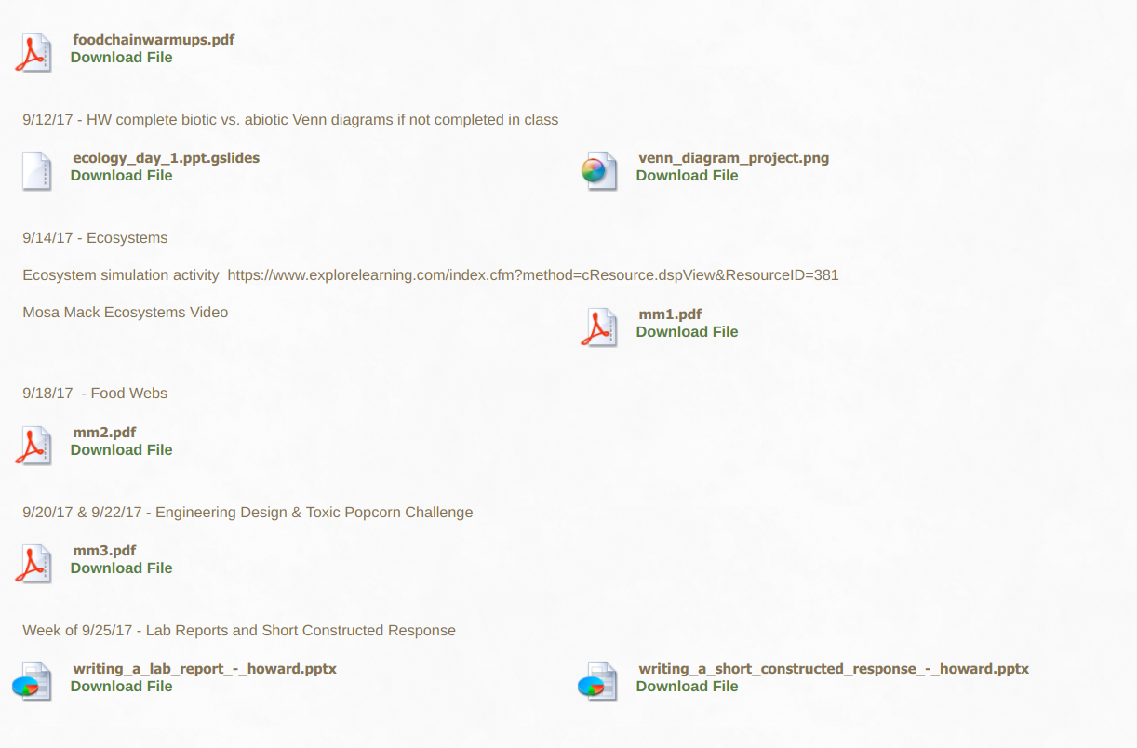

Slide 8
Writing Requirements
Lab Reports (a minimum of 2 per MP)
Short Constructed Response (a minimum of 2 per MP)
Writing folders

Slide 9
My classroom
RESPECT in our interpersonal interactions are very important in my room. I have zero tolerance for name calling or students not treating each other with respect
ORGANIZATIONAL SKILLS We are working on becoming more organized in all of our classes
VOCABULARY We use a word wall and review vocabulary frequently
INQUIRY AND PROBLEM SOLVING Through laboratory activities
WRITING SKILLS (next slide)

Slide 10
Grades
Lab Reports and Tests (Summative) count as 70% of the grade
Homework, Classwork, Exit Tickets, Quizzes, Notebook checks (Formative) count as 30% of the grade
*district policy*

Slide 11
Back to School Night
6th and 7th Grade Science LBMS
Room 3051 – Mrs. Howard
khoward@longbranch.k12.nj.us

